Slide 1
Social Inclusion and Awareness Raising In an Ageing Society
FERDOUS ARA BEGUM Former Member, UN CEDAW Committee
Second International Forum
On the Rights of Older Persons,
Mexico City,
3-6 June, 2014

Slide 2
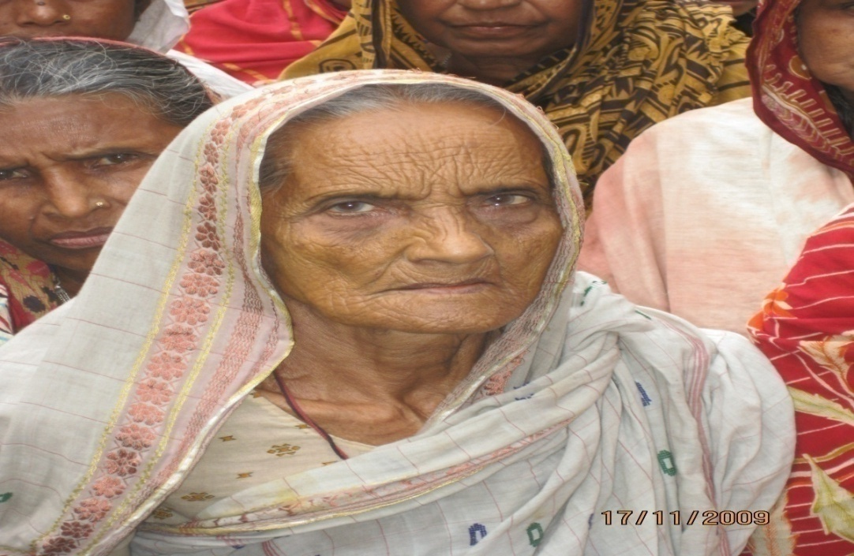
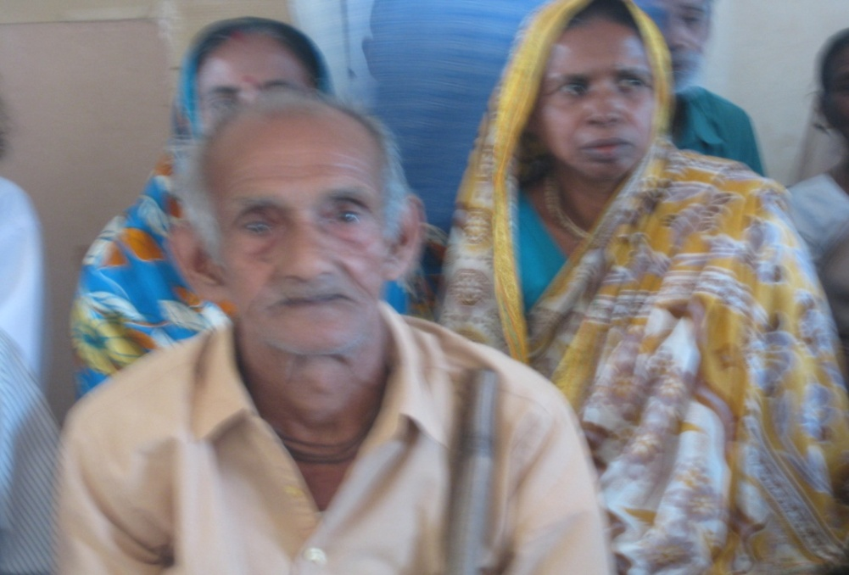
Introduction
I would like to begin my presentation with a story published in the New York Times on Op-Ed page on 5th May, 2014. This was the story of social exclusion and loneliness of an old man in his 70s in the Bangladeshi middle class society…
In absence of social awareness about an inclusive society and active ageing agenda, older women and men continue to face challenges and barriers, neglect and isolation in every aspect of their lives and denial of their human rights.
To prevent social exclusion and abandonment in old age a greater understanding and knowledge base on the divers nature of ageing including positive interventions and awareness creation is necessary at the national level.

Slide 3
Some key issues on ageing and social inclusion
Understanding population dynamics in both developed and developing countries
Gendered nature of ageing
Challenges, obstacles and risk factors associated with ageing that may prevent older people to enjoy their Human Rights
Social inclusion and awareness raising : A policy approach to protect the human rights of older people
Some Important issues to be considered for the policy actions towards Social Inclusion.
Awareness raising on social inclusion and older people's rights
Bangladesh scenario and Government initiatives
Recommendations

Slide 4
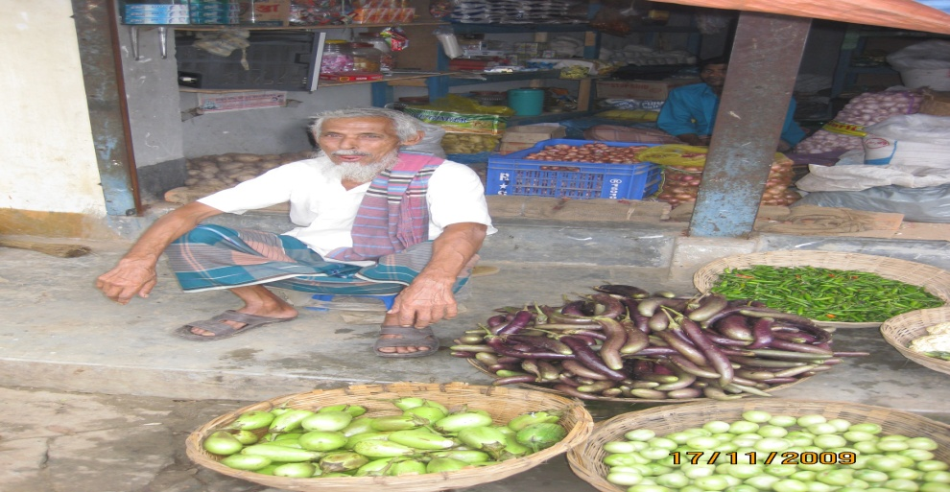
Understanding population dynamics in both developed and developing countries
As per UNDESA Population Ageing and Development Chart, 2011, proportion of global population aged 60 years and older is going to be double between 2000 and 2050 from 10 percent to 21 percent. Same source revealed that at present there are 82 men for every 100 women at the age of 60; there are only 55 for every 100 women at the age of 80.
The Executive Summary Report of World Population Ageing, 1950-2050, reflects that the rapid population aging may create enduring consequences for enormous opportunities as well as equally enormous challenges for all societies in the socio- economic and political arena.

Slide 5
Demographic differences between developed and developing countries
While both developed and developing countries face the consequences of population ageing, but it is particularly critical issue in developing countries. Currently 64% of the world’s older people live in Less Developed Countries. By 2050, this figure will rise to 80% .
The number of older women living in less developed regions will increase by 600 million between the years 2010 and 2050.
In developed countries there is a larger concentration of population in urban areas, whereas in developing countries a higher percentage of older persons live in rural areas, often in multigenerational households and dependent on the family.
Due to populations’ different dynamics and socio-economic trends, policy approaches will be different in developed and developing countries

Slide 6
Gendered Nature of Ageing
Gender dimension of ageing reflects that both men and women face discrimination, violence and abuse due to age, but women experience this differently due to subordinate status and stereotyped attitude towards older women.
As per the General Recommendation Number 27 of the CEDAW Convention, as women age and their independence decline they become more vulnerable to exploitation, violence and sexual abuse. There are common perceptions and stigmatization against older women that they are no longer economically or reproductively useful and burden on the family.
Older women mostly live longer than men and live alone with limited access to basic human rights and almost no access to justice. Older Women live in rural and remote areas suffer from extreme poverty.

Slide 7
Challenges and obstacles that may prevent older people to enjoy their human rights
UN High Commissioner for Human Rights conducted a public consultation on 15th April, 2013 and concluded that the key challenge to the full realization of older people’s rights are their invisibility within the existing human rights frameworks.
Older people face very specific threats to their rights in relation to age
discrimination, such as: limited access to health care, employment, information and education, housing and transportation, property and inheritance rights and access to basic needs and care services.
They face particular threats to their rights from different forms of violence and abuse including limited access to justice and equality before the law. Older persons with disability, ethnic minority, refugee or stateless persons or detainees face huge discrimination and exclusion due to age.
In absence of political commitment for the prohibition of age discrimination in the national legal system and in absence of Action Plans for social inclusion, older persons continue to suffer from social exclusion and indignity of life.

Slide 8
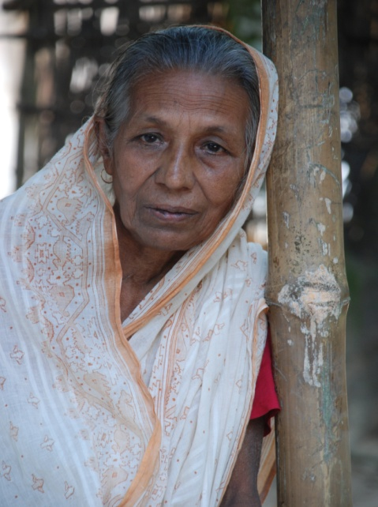
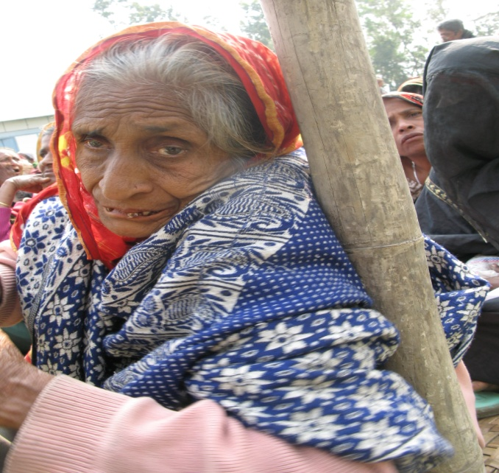
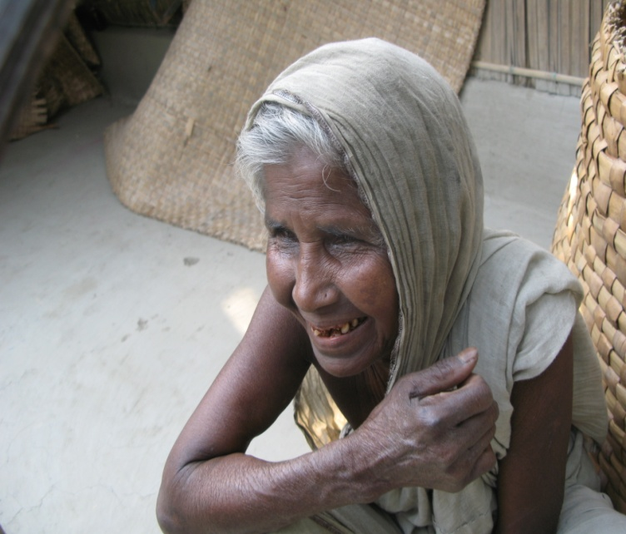
Risk Factors Towards Social Exclusion
Older People from the age group of over 80 years are particularly at risk of social exclusion, loneliness and abandonment due to various physical and mental illnesses and limitations, such as blindness, loss of hearing, loss of appetite and other old age related illness including people who are unable to live without assistance.
Ageing People at risk of social exclusion who are suffering from dementia and Alzheimer diseases and in need of long term care.
Men and women of very old group with disabilities, living in rural and remote areas face real threat to meet their basic day to day needs of medication, food and care services.

Slide 9
Understanding Social inclusion: A Policy Approach to Protect the Human Rights of Older People-1
The concept of social inclusion and active ageing refers to the continuing participation in social, economic, cultural and civic affairs during the whole life cycle of a human being and not simply the ability to be physically active to participate in the labor market.
The Special Rapporteur on the rights to the highest attainable standard of physical and mental health considers that there must be a paradigm shift from the perception of older persons as a "social burden” to one that emphasizes the process of “active ageing” and that will reorient our ideas about ageing to focus on the continuing contribution of older persons to society.
According to the Laidlaw Foundation, a Toronto based social justice agency
social inclusion is a multi-dimensional concept that broadens goals of poverty reduction to goals that call for equal opportunity, strengthening capability and increasing participation. Therefore, social inclusion not only encompasses income, poverty and inequality but also broadens the scope of physical, social, economic and political involvement dimensions.

Slide 10
Understanding Social inclusion: A Policy Approach to Protect the Human Rights of Older People-2
Ensuring the political participation of older persons is necessary to guarantee that States develop age sensitive laws and policies to implement and mainstream access to the required protection and services
Most countries have some form of basic non-contributory pensions for certain social groups, but eligibility criteria for the pension may differ greatly. An increasing number of countries are considering the introduction of a non-means-tested pension as a way to mitigate poverty and provide at least a minimum level of subsistence for older people
However, social inclusion cannot be the only solution, but it will be a step towards closing social and economic distances that force people to the margins of society
Many countries have implemented policies to combat social exclusion, but fewer have adopted a social inclusion framework. The UK, Ireland and Australia are some countries which have delineated a clear action plan to promote social inclusion

Slide 11
Some Important Issues to be Considered for the Policy Actions towards Social Inclusion Through Healthy and Active Ageing Agenda
Though policy directions towards social inclusion are country specific, however some basic requirements from the point of view of human rights of older people are more or less similar to each and every country, which are summarized below :
Non Discrimination and Recognition before the Law
States Parties should adopt gender‐sensitive and age‐specific policies and measures to ensure that older men and women participate fully and effectively in the political, social, economic, cultural, civil and all other fields in their societies on equal terms. Prohibition of discrimination is one of the pillars of the International Human Rights law.
Collection of Data and Statistics
States Parties should collect, analyze and disseminate data disaggregated by age and sex, including data on the issues of poverty, illiteracy, unpaid work, access to health care, housing, social and economic benefits and employment and incidences of violence .
Contd……….

Slide 12
Protection from Violence and Abuse and Access to Justice
States Parties have an obligation to enact laws against violence and abuse committed to older people including people with disabilities, which may occur at home by family members or care givers or in institutional settings and prosecute and punish all acts of violence against them. The abuse may be of physical, verbal, emotional, psychological, financial or sexual in nature.
Protection against poverty and marginalization
Older people face poverty and inadequate living conditions globally, with the most critical problems including homelessness, malnutrition, shortage of food ,unattended chronic diseases, lack of access to safe drinking water, electricity or sanitation and income security. Older people living in rural and remote areas are most likely to be excluded from all social safety net and older women are particularly vulnerable to this situation.
Saving for old age
Elderly care, both supply of medicine and nutrition along with long-term treatment needs economic solvency. So it is essential to save for old age when people are young and can make their old age as a gold age.
Contd………

Slide 13
Right to work
States parties have an obligation to facilitate the participation of older persons in paid work without facing any discrimination based on their age and sex. States parties should ensure that they are not forced into early retirement or similar solutions and do not discriminate against pension benefits. States parties should also monitor the impact of gender pay gaps on older women.
Access to Education and participation in the decision making process.
States parties have an obligation to ensure equality of opportunity in the field of education for older people and to ensure that they have access to adult education and lifelong learning opportunities.
Political Participation
States parties have an obligation to ensure that older persons have the opportunity to participate in public and political life and hold public office at all levels in the decision making positions and that older men and women have the necessary documentation to register to vote and run as candidates for election.
Protection against Health risks and access to Services including long time care
States Parties should adopt a comprehensive health policy to ensure affordable and accessible health care including long term care , training for healthcare providers in geriatric illness and palliative care. The policy also should include interventions promoting behavioral and lifestyle changes to delay onset of health problems.
Contd………

Slide 14
Right to adequate housing and food
States parties should provide adequate protection for housing needs of ageing people. They also should protect older people against forced evictions and homelessness. It is important that States Parties should ensure adequate food and nutrition to older people as there day to day nutrition needs are overlooked by family or in institutional settings.
Protection from the impact of climate change and natural and manmade disasters.
Older persons may face barriers to access to food and aid in emergency situations due to armed conflict or natural disasters. Special attention need to be taken in this respect.
Care Services : Home care and Institutional care
Care services play an important role in the life of older people, especially when they are incapacitated and dependent on aid. As the family and institutions are the primary care providers to the ageing population, family members and institutional care service providers need to be well trained about the palliative care and providing care with love. There should be an uniform standard for all institutional care.

Slide 15
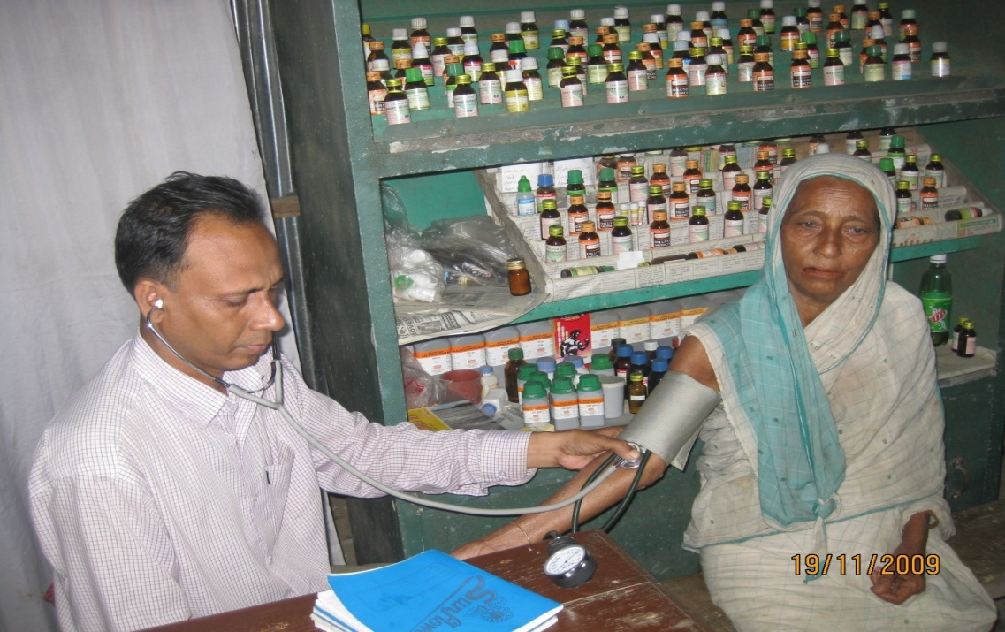
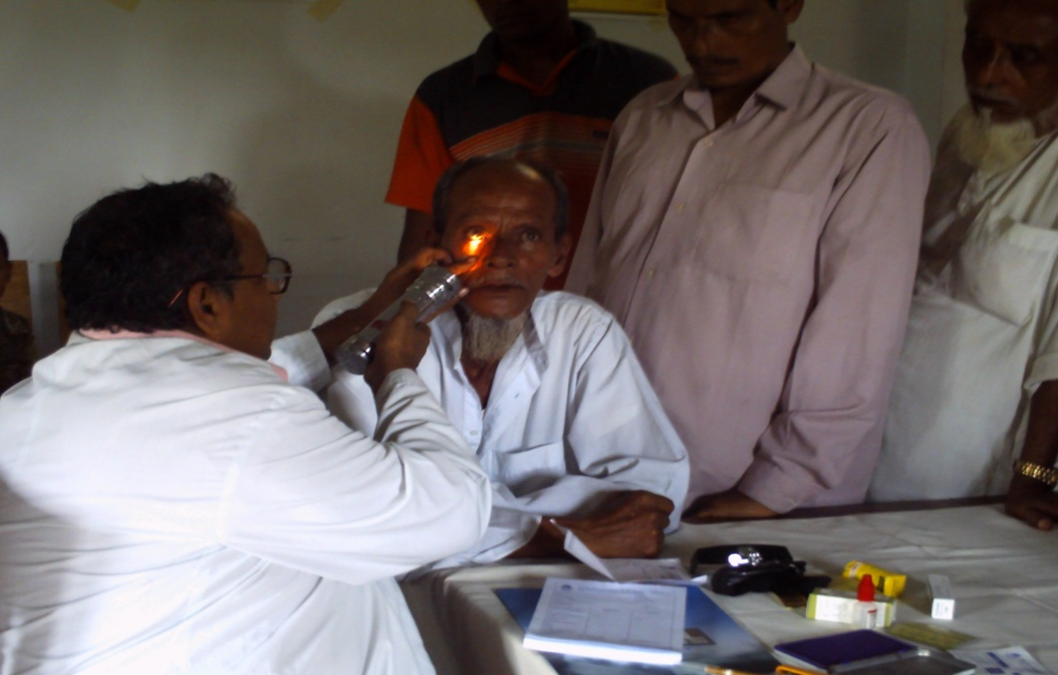
Care for Dementia and Alzheimer patients
People who are suffering from dementia and Alzheimer diseases face abuse and discrimination at home or institutional settings from their family members or from the care givers .This is a great challenge for Governments and social workers too.

Slide 16
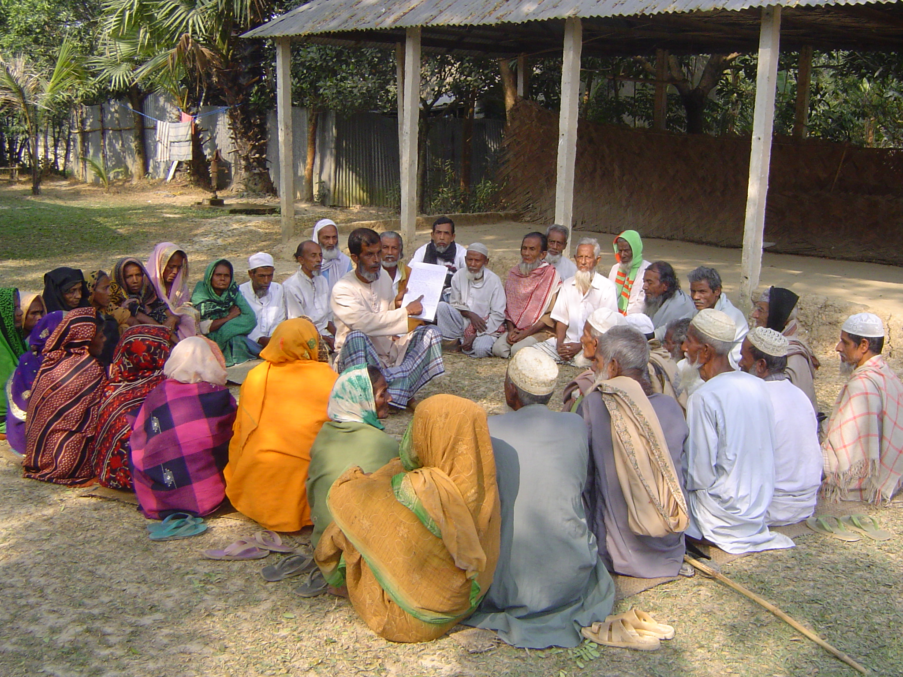
Intergenerational solidarity
Intergenerational solidarity and social networking and friendship between young and old is important to prevent neglect and social exclusion.

Slide 17
Awareness Raising on Social Inclusion and Older People's Rights
Awareness raising for social inclusion and older people's rights from the perspective of age and gender is important to sensitize community, society and government . In some Latin American and European countries, as well as in Australia and Canada, the medical profession and existing health and social service networks have played a leading role in raising public awareness on the prevention of elder abuse and stigmatization through the process of social inclusion.
Creating a strong network on the issues of older people's rights across the nation and exchange of good practices regarding medical and legal services, training of health care providers and case workers is important so that older men and women can share their experiences, develop the strength to cope with their situation and raise their self esteem.
Contd…….

Slide 18
States Parties should use print and electronic media to project good images of older people as care givers and unpaid workers in the family for migrant children or sick family members.
Societies and employers often devalue older workers as less productive, more prone to ill health or disease, incapable of learning or adapting to technological changes. States Parties should initiate nationwide awareness campaign to reverse this negative perception and project and utilize older people's knowledge and experiences for socio economic development.
Economic and Social Commission for West Asia reported at the UN that most ESCWA countries have made a significant progress in raising public awareness towards addressing ageing issues at both the governmental and civil society levels
Commemorating the International Older Person's Day on 1st October, World Elder Abuse Awareness Day on 15th June, have become a major national venue for raising awareness on ageing issues and the rights of older persons.

Slide 19
Bangladesh Government Initiatives to Address the Issues of Ageing Population
The Government of Bangladesh has adopted a National Policy for Ageing Population on 11th February , 2014, based on the Madrid International Plan of Action on Ageing.
Government also enacted a new law, making it legally binding upon adult children to provide care and support to their elderly parents
Other programs are Pensions, as retirement benefit for Government Employees, family pension for widows in the public sector
Old Age Allowance is the largest single program for the benefit of poor older persons in the country. Number of beneficiaries are 2.5 million who get 300 taka per month though the total number of eligible older people is much higher

Slide 20
Recommendation:
Governments and NGOs need to develop National Policies and Action Plans to address older people's rights and well being through innovative protection strategies based on social inclusion mechanism . It is important to understand older persons choices and basic needs in developing and implementing interventions and services.
2. Governments and NGOs should encourage media to address negative stereotyping of older men and women as dependent, fragile and useless through projecting and promoting good images of older people as caregivers in the family. Their past contribution to the family and society should also be projected in order to change the mindset of people. They should be treated as a source of knowledge from their life experiences.
Contd…….

Slide 21
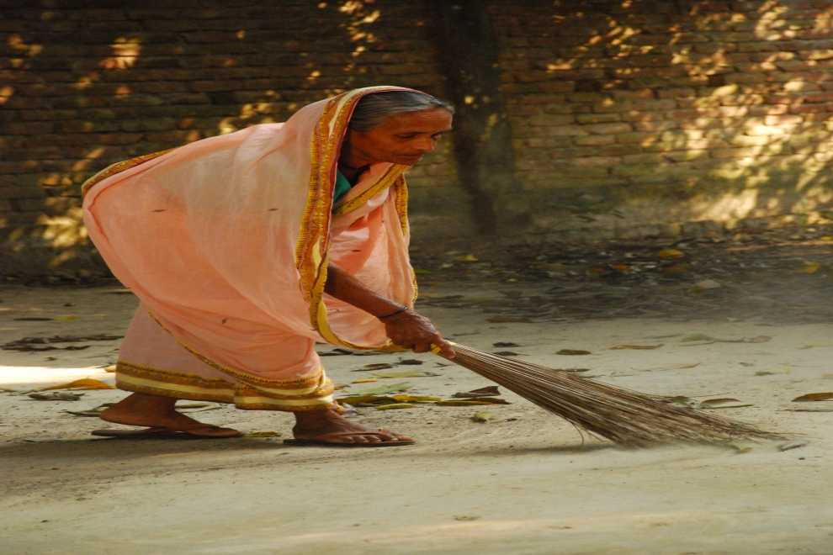
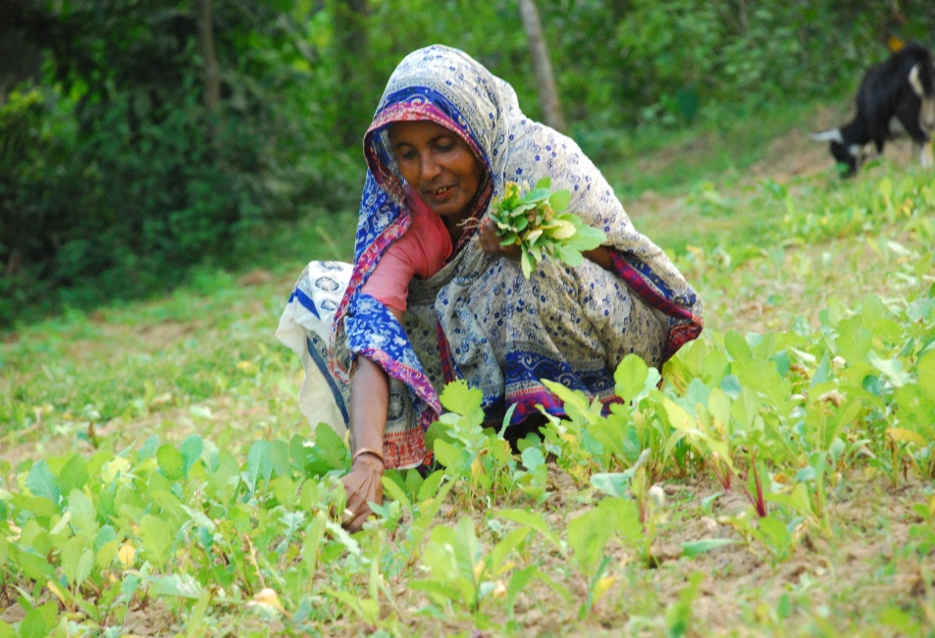
3. Governments should initiate nationwide advocacy programs about the exiting legislative measures to protect the dignity and rights of older people and to prevent elder abuse. It should ensure the rights of older people to have access to essential public services.
4. Governments and NGOs should take initiatives to address poverty and marginalization of older men and women in rural areas through providing support systems and collateral free microcredit to them including affordable transportation to enable them to participate in the economic and social life and community activities.
5. States Parties should also provide non contributory social pensions to address poverty among ageing Governments also need to provide affordable water, electricity and other utilities to older people so that they may have a better life.
Contd……

Slide 22
6.Governments should adopt a comprehensive health policy for the protection of mental and physical health needs of older people .This should ensure affordable and accessible health care and include interventions promoting behavioral and lifestyle changes to delay onset of health problems.
7. Post- menopausal difficulties and diseases, neglect in disability and absence of geriatric medicine require special attention for the health safety of ageing women. Health care providers with adequate training and knowledge should take care of these issues.
8. Protection strategy should take care of people from different age groups beyond 70 years, who have different kinds of health needs, which may vary depending on their health conditions and economic and social situation including long term health care.
Contd……..

Slide 23
9. Adequate training for health care providers and family members regarding human rights and essential medical services are important so that they may provide services with love and care. Intergenerational solidarity and providing care to elders with love are important .
10. NGOs can play a great role in creating massive awareness campaign regarding elder abuse and sexual violence against older women. They can submit shadow reports or alternative reports to the CEDAW Committee on the basis of General Recommendation No 27 of the CEDAW Convention, so that the committee can raise questions on these issues to the States Parties for remedial measures.
11. It is essential to generate sex and age desegregated data on older persons so that Governments can formulate age and gender specific policies and programs.
12. Corporate business houses should take initiatives to create facilities , hospitals and old homes for ageing population. Governments should provide tax breaks to them for investment in the industries benefiting older people.

Slide 24
Conclusion
To improve the prevention and support mechanism for older people who are at risk, effective protection strategies including appropriate legislation and policy measures, increasing knowledge base and public awareness about the issue, capacity building, treatment and empowerment of the victims and vulnerable groups are essential.
Professional training for care providers along with effective implementation of the Madrid International Plan of Action on Ageing and General Recommendation No 27 of the CEDAW Convention are very important to protect the human rights of older men and women, so that they may have a decent and dignified life.

Slide 25
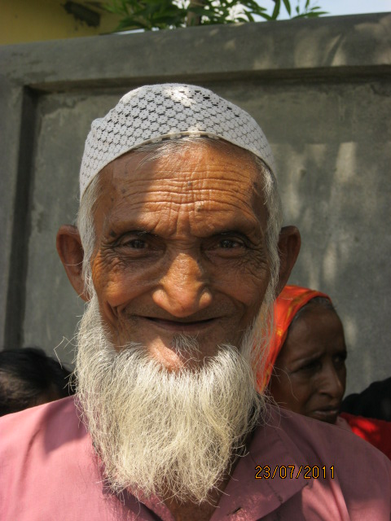
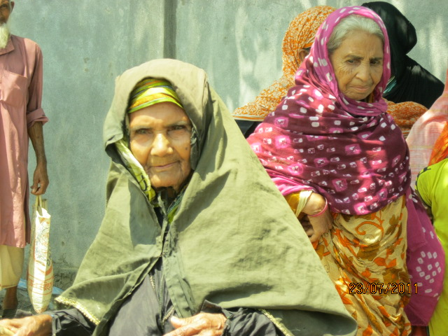
Thank You

